Slide 1
INTRODUCTION TO ROS
ROBOTIC SYSTEMS(UE22EC342BC2) : AHP 1

Slide 2
What is ROS?
ROS (Robot Operating System) is an open-source framework that provides tools, libraries, and conventions for building robotic applications. It simplifies the process of designing and deploying robotic systems.
ROS is not an operating system but a middleware for communication and coordination of robot components.

Slide 3
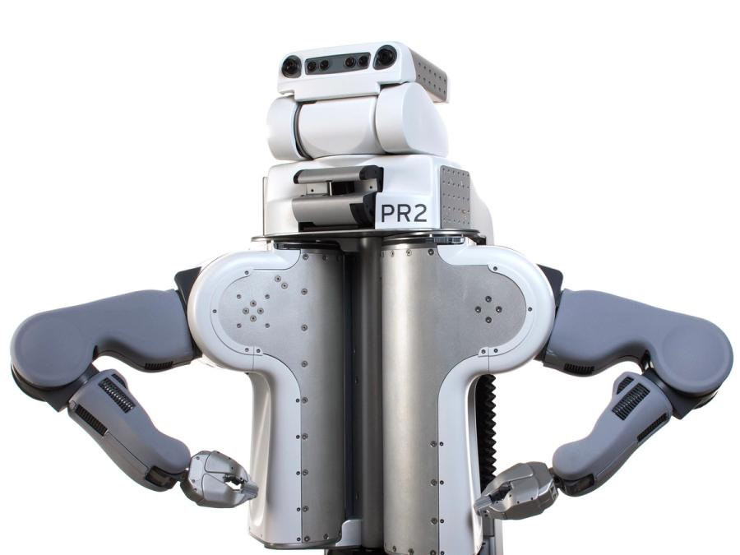
How Did ROS Originate?
Origin: Developed at Willow Garage in 2007 to facilitate rapid development and research in robotics.
FUN FACT: Willow Garage also created the PR2 robot, which folded towels autonomously using ROS!

Slide 4
How is ROS Useful?
ROS allows developers to focus on robot logic, instead of building everything from scratch. It handles communication between components, sensor integration, and more.
ROS has become the standard in robotics research and development worldwide.

Slide 5
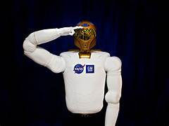
Where is ROS Useful?
Autonomous vehicles, drones, industrial robots, medical robotics, research.
Robotics startups, research labs, major companies like Google, Tesla, and Boston Dynamics.
Over 10,000 developers worldwide contribute to the ROS ecosystem.
ROS is used by NASA for controlling robots in space, including the Robonaut aboard the International Space Station.

Slide 6

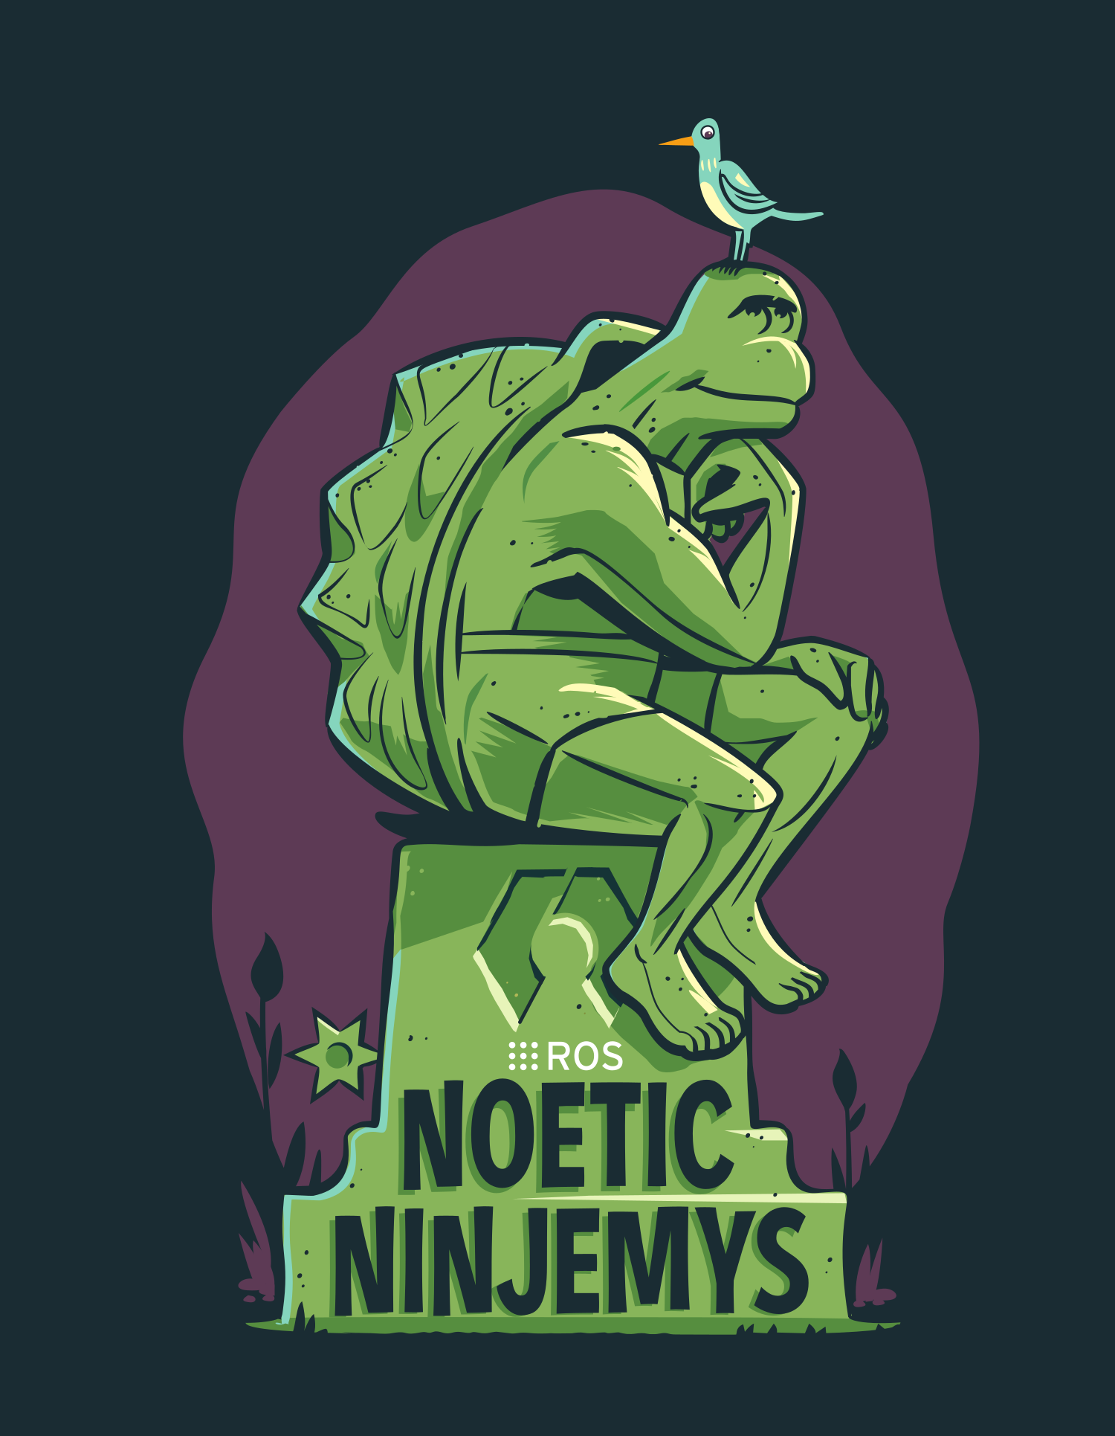
History of ROS
ROS 1 (2007) to ROS 2 (2017). ROS 1 will reach end of life with noetic being the last ros 1 distro. ROS 2 supports real-time performance, multi-robot systems, and more platforms.
ROS 2 was designed to be more secure and reliable, with built-in real-time capabilities.

Slide 7
ROS 1 vs ROS 2
Communication: ROS 1 uses TCP(transmission control protocol) , ROS 2 uses DDS for real-time communication.
Platform Support: ROS 1 is Linux-only; ROS 2 supports Linux, Windows, and RTOS.
Security: ROS 2 includes encryption and authentication.
QOS: ROS 1 doesn’t provide built-in QoS features. DDS offers extensive QoS settings, such as reliability, durability, latency, and deadline constraints.

Slide 8
Core Concepts – Nodes
Nodes are executables that perform specific tasks within a robotic system.
A single robot might have hundreds of nodes working together to accomplish tasks like perception, motion, and control.

Slide 9
Core Concepts – Topics
Named communication channels for exchanging data between nodes asynchronously.
Topics are one-to-many, allowing multiple subscribers to receive data from a single publisher.

Slide 10
Core Concepts – Publisher & Subscriber
Publisher: Sends data to a topic.
Subscriber: Receives data from a topic.
You can create multiple publishers for one topic, making it a powerful communication tool.

Slide 11
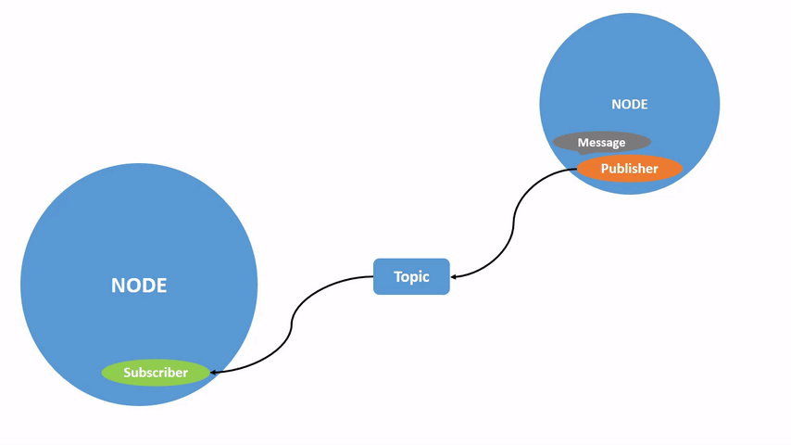

Slide 12
Core Concepts – Services
Services enable synchronous communication with request-response patterns (e.g., start/stop actions).
Services are perfect for "order-and-wait" operations, like moving a robot arm to a target position.

Slide 13
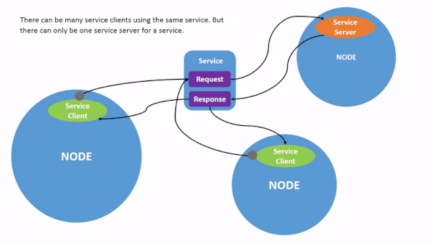

Slide 14
Core Concepts – Actions
Actions allow for long-running tasks and provide feedback and cancellation options (e.g., robot moving to a destination).
Actions are like requesting a robot to "pick up the object" and receiving updates on the progress.

Slide 15
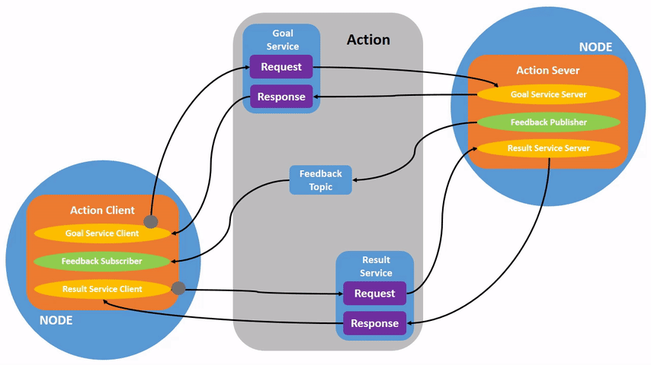

Slide 16
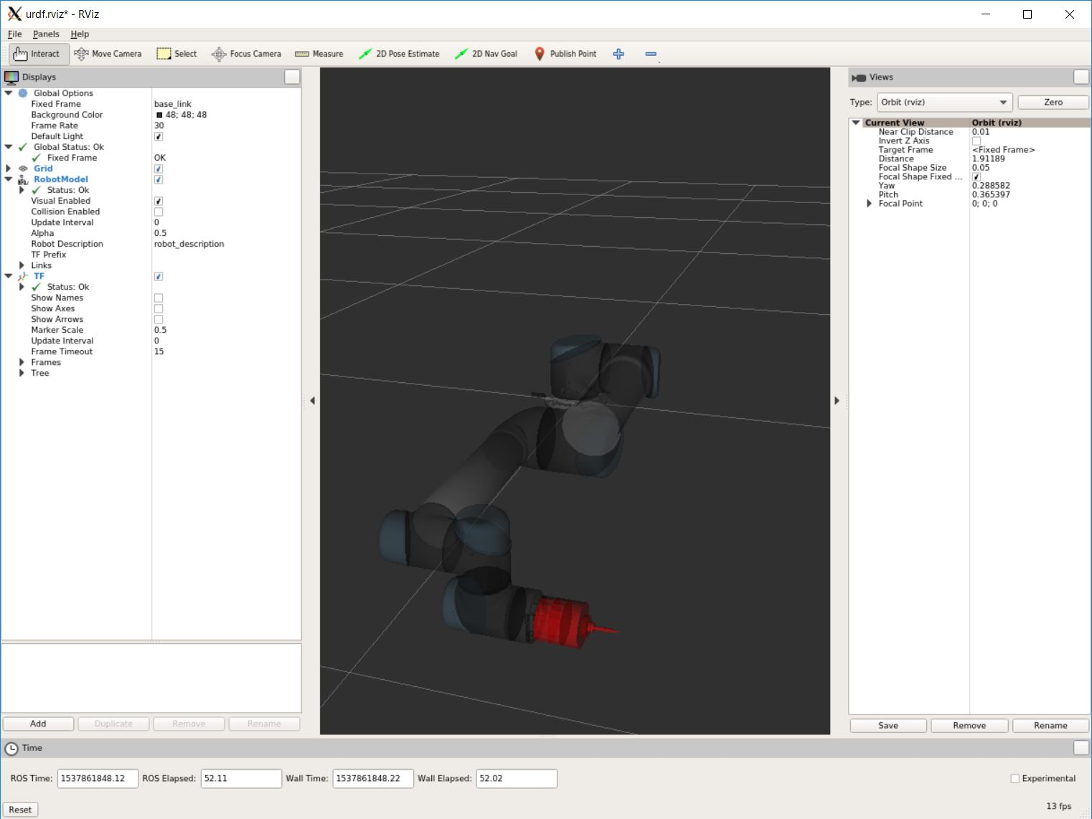
Core Concepts – URDF
URDF is an XML format that defines the robot’s physical and kinematic properties.
You can visualize robots described in URDF before even building them!

Slide 17
Core Concepts – Workspaces
A workspace is a directory for developing and building ROS packages.
Workspaces allow you to work on multiple robotics projects in isolation, keeping each project independent.

Slide 18
Core Concepts – Packages
A package is the primary unit of organization in ROS, containing nodes, configurations, and dependencies.
ROS packages can be reused across projects, similar to libraries in programming.

Slide 19
Core Concepts – Launch Files
Launch files start multiple nodes and configurations at once, simplifying robot deployment.
BASICALLY, You can launch your entire robot system with a single command!

Slide 20
TF (Transform Library)
TF manages transformations between different frames of reference on the robot (e.g., arm to gripper).
Even while the robot moves, TF can keep track of all the transformations in real time.

Slide 21
Gazebo Simulation
Gazebo is a powerful 3D physics simulator used to test robots in virtual environments.
Gazebo is often used in robotic APPLICATIONS to test algorithms and strategies in a safe environment.

Slide 22
RViz
RViz is a 3D visualization tool for monitoring sensor data and robot states.
You can watch your robot navigate in a simulated environment with live camera feeds and LiDAR scans.

Slide 23
Bag Files
Bag files are used to record and replay ROS data, ideal for debugging.
You can replay a robot's entire mission using a ROS bag, making debugging much easier.

Slide 24
HOW CAN YOU BECOME A ROS DEVELOPER?
MORE OF ROS 2 ON THE https://docs.ros.org/en/humble/index.html DOCUMENTATION, EXPLORE ALL THE TUTORIALS.

